Slide 1
CHAPTER 9
HISTOGRAM PROCESSING

Slide 2
WHAT WILL WE LEARN?
What is the histogram of an image?
How can the histogram of an image be computed?
How much information does the histogram provide about the image?
What is histogram equalization and what happens to an image whose histogram is equalized?
How can the histogram be modified through direct histogram specification and what happens to an image when we do it?
What other histogram modification techniques can be applied to digital images and what is the result of applying such techniques?

Slide 3
What is a histogram?
The histogram of a monochrome image is a graphical representation of the frequency of occurrence of each gray level in the image.
The data structure that stores the frequency values is a 1D array of numerical values, h, whose individual elements store the number (or percentage) of image pixels that correspond to each possible gray level.

Slide 4




What is a histogram?

Slide 5
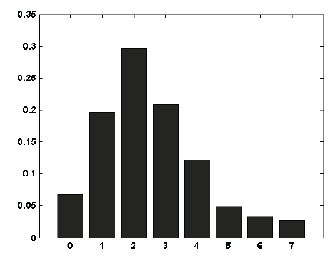
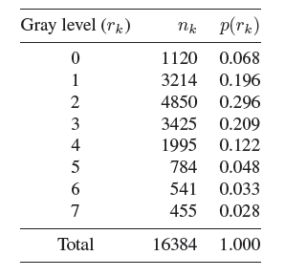
Histogram example
Example 9.1: histogram for a hypothetical image containing 128×128 pixels and 8 gray levels.

Slide 6
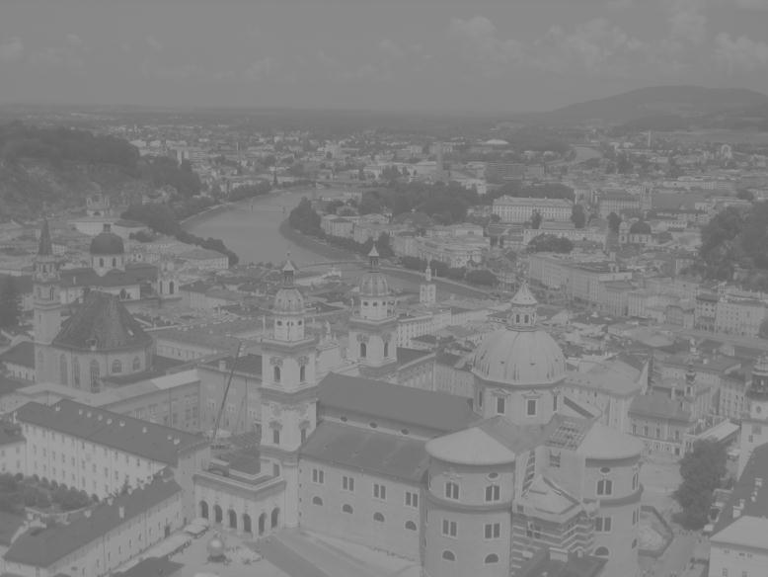
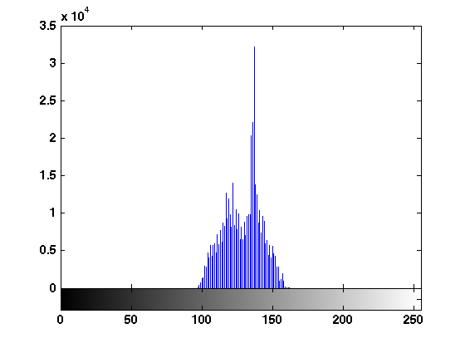
Examples of images and their histograms (Example 9.2)
In MATLAB: imhist

Slide 7
Interpreting image histograms
Histograms have become a popular tool for conveying image statistics and helping determine certain problems in an image.
A histogram carries significant qualitative and quantitative information about the corresponding image (e.g., minimum, average, and maximum gray level values, dominance of bright or dark pixels, etc.).
A histogram is not enough to draw qualitative conclusions about the overall quality of the image, presence or absence of noise, etc.

Slide 8
Interpreting image histograms
Although a histogram provides the frequency distribution of gray levels in an image, it tells us nothing about the spatial distribution of the pixels whose gray levels are represented in the histogram.
Histograms can be used whenever a statistical representation of the gray level distribution in an image is desired.
Histograms can also be used to enhance or modify the characteristics of an image, particularly its contrast.

Slide 9
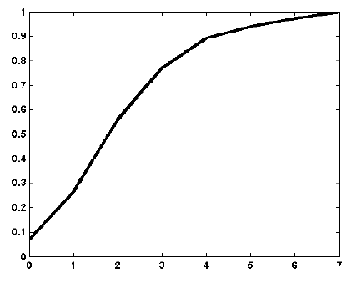
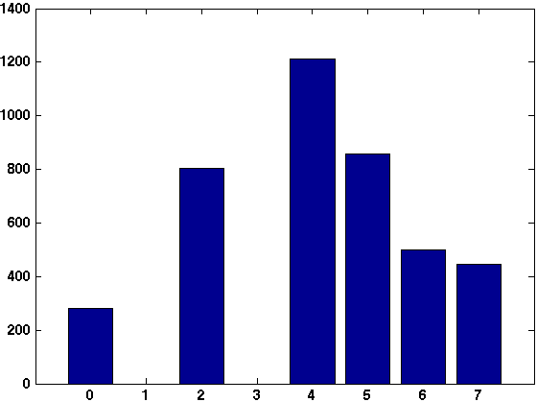
Histogram equalization
Example 9.3:

Slide 10
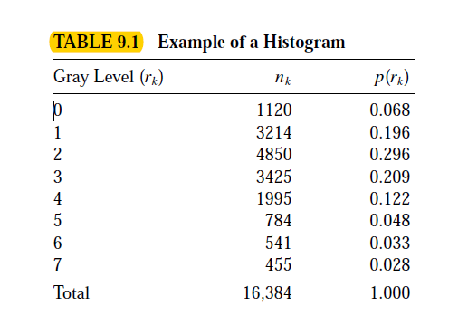
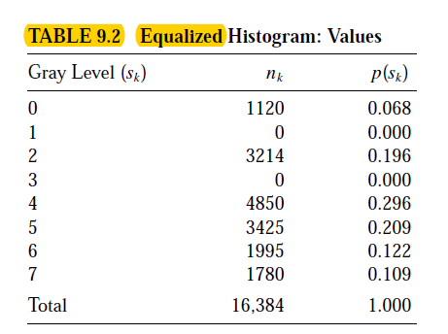

Slide 11
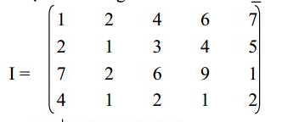
Example:
Calculate and equalize histogram using the cdf of the image with new_level =4

Slide 12
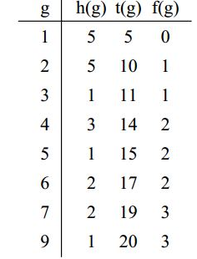
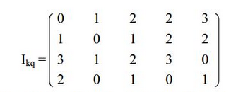
Solution

Slide 13
Histogram equalization
In MATLAB: histeq Example 9.4:
I = imread('sydney_low_contrast.png');
I = im2double(I);
J = histeq(I);
figure, subplot(2,2,1), imshow(I), ...
subplot(2,2,2), imshow(J), ...
subplot(2,2,3), imhist(I), ylim('auto'),...
subplot(2,2,4), imhist(J), ylim('auto')

Slide 14
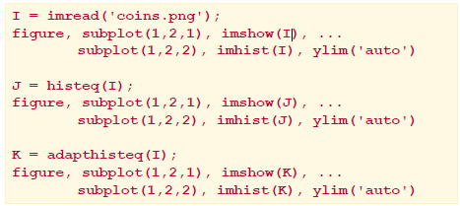
Global vs. local histogram equalization
In MATLAB: histeq and adapthisteq

Slide 15
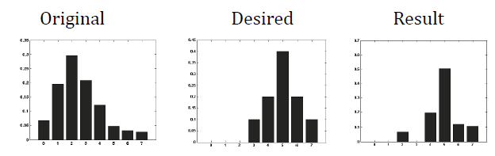
Direct histogram specification 
Example 9.6:

Slide 16
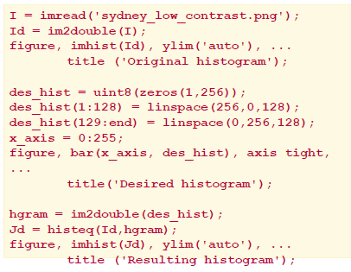
Direct histogram specification
In MATLAB: histeq

Slide 17
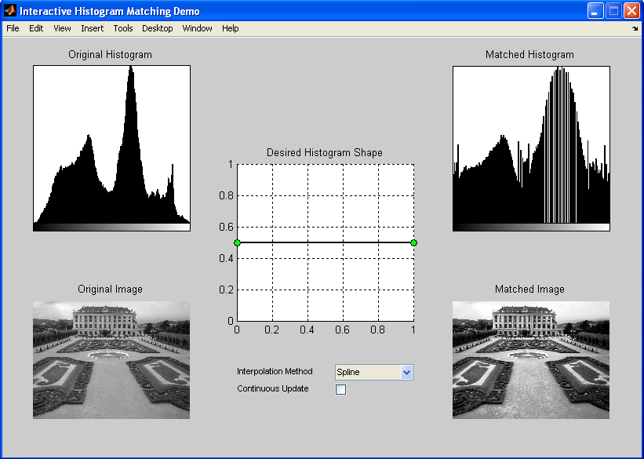
Direct histogram specification
Interactive histogram matching tool (ihmdemo)

Slide 18
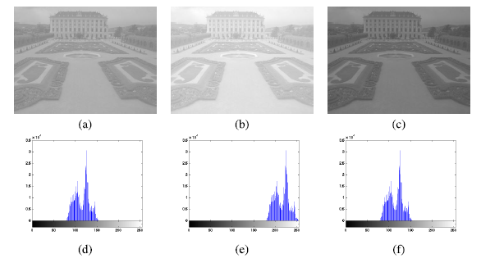
Other histogram modification techniques
Histogram sliding
(Example 9.8):

Slide 19
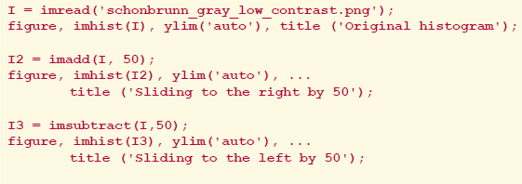
Histogram sliding
In MATLAB:
imadd and imsubtract

Slide 20
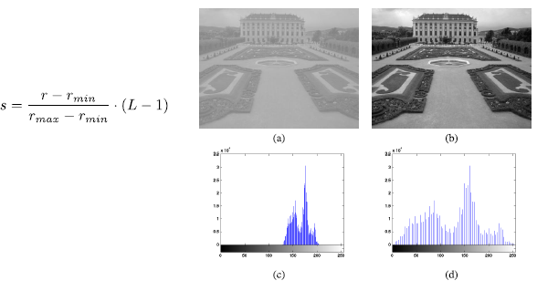
Histogram stretching (Example 9.9):

Slide 21

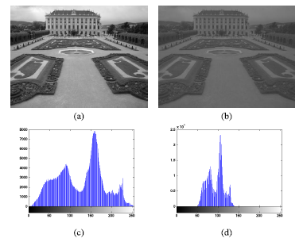
Histogram shrinking (Example 9.10):

Slide 22
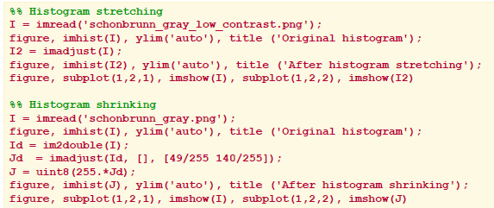
Histogram stretching and shrinking
In MATLAB:
imadjust

Slide 23
Hands-on
Tutorial 9.1: Image histograms (page 188)
Tutorial 9.2: Histogram equalization and specification (page 191)
Tutorial 9.3: Other histogram modification techniques (page 195)

